Slide 1
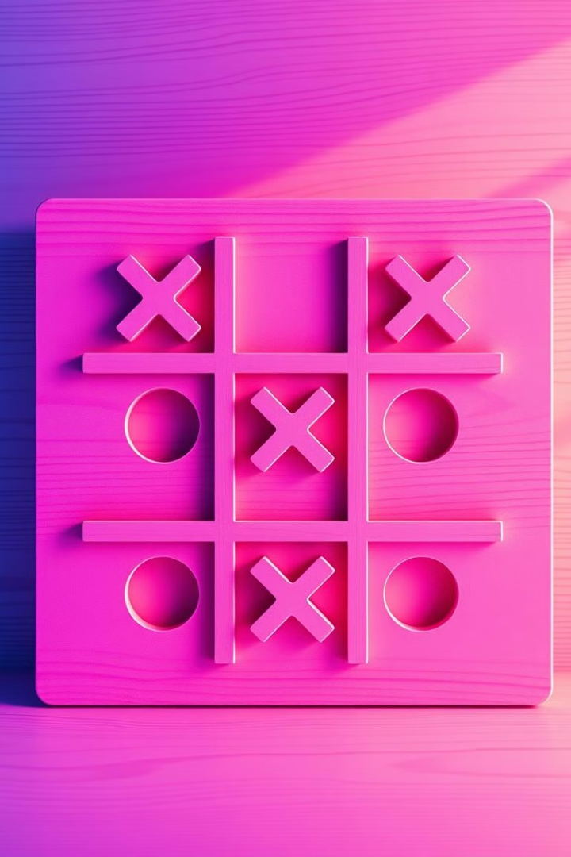
Tick-Tack-Toe Game in C++
This guide provides a step-by-step explanation for building a functional Tick-Tack-Toe game using C++. The guide covers game rules, board creation, input handling, game logic, win checking, and replay functionality.

Slide 2

Introduction to Tick-Tack-Toe
Classic Game
Objective
Tick-Tack-Toe, also known as Noughts and Crosses, is a popular two-player game played on a 3x3 grid.
The goal is to get three of your marks (X or O) in a row, column, or diagonal.
Gameplay
Players take turns placing their marks on the board until a player wins or the board is filled, resulting in a draw.

Slide 3

Understanding the Game Rules
1
Players
2
Marks
Two players take turns placing their mark on the board.
One player uses "X", while the other uses "O".
3
Winning
4
Draw
A player wins by having three of their marks in a row, column, or diagonal.
If all squares are filled and no player has three in a row, the game ends in a draw.

Slide 4
Planning the Game Structure
1
Board Representation
Create a data structure to represent the 3x3 game board, such as a 2D array.
2
Player Turns
Implement a mechanism to alternate between player turns, keeping track of the current player.
3
Input Handling
Allow players to input their desired position on the board using keyboard input.
4
Game Logic
Develop algorithms to check for winning conditions and update the game state.
5
Display
Implement a display mechanism to visually present the game board and update it after each move.

Slide 5
Creating the Game Board
Data Structure
Initialization
Visualization
Use a 2D array, represented as a vector of vectors, to represent the game board.
Initialize the board with empty spaces, ready for players to place their marks.
Implement a function to display the board, clearly showing the player's marks and empty spaces.
Each cell in the array will hold a character representing the player's mark ("X", "O", or an empty space).
This sets the initial state of the game board at the beginning.
This function will update the display after each move.

Slide 6

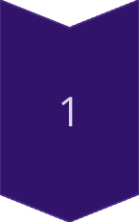
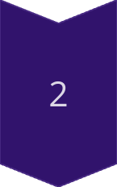
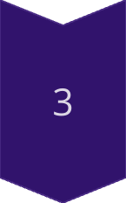
Implementing Player Input
Input Gathering
Prompt players to input the desired square number on the board, from 1 to 9.
Input Validation
Check if the entered square is valid, ensuring it's within the bounds of the board and not already occupied.
Update Board
If the input is valid, update the corresponding cell in the board array with the current player's mark.

Slide 7

Handling Game Logic
Check for Winning Conditions
Check if three consecutive marks are in a row, column, or diagonal.
Update Game State
If a player wins, declare them the winner and end the game.
Check for Draw
If the board is full and no player has won, declare a draw.
Switch Turns
After each move, switch the current player to the next player.

Slide 8




Checking for a Winner
Row Check
Column Check
Diagonal Check
Iterate through each row and check if all cells have the same mark.
Iterate through each column and check if all cells have the same mark.
Check both diagonals for three consecutive marks of the same player.

Slide 9

Handling Game Flow and Turns
1
Start Game
Initialize the game board and set the first player.
2
Player Turn
Prompt the current player for their move, gather input, validate it, and update the board.
3
Check for Winner
After each move, check for winning conditions, a draw, or continue to the next player's turn.
4
End Game
Display the result of the game (win, draw, or invalid input) and provide the option to play again.

Slide 10

Adding Replay Functionality
1
Prompt
2
Reset
After the game ends, ask the players if they want to play again.
If the players choose to replay, clear the game board and reset all game state variables.
3
New Game
Start a new game by switching the first player or keeping the same player order.

